Slide 1
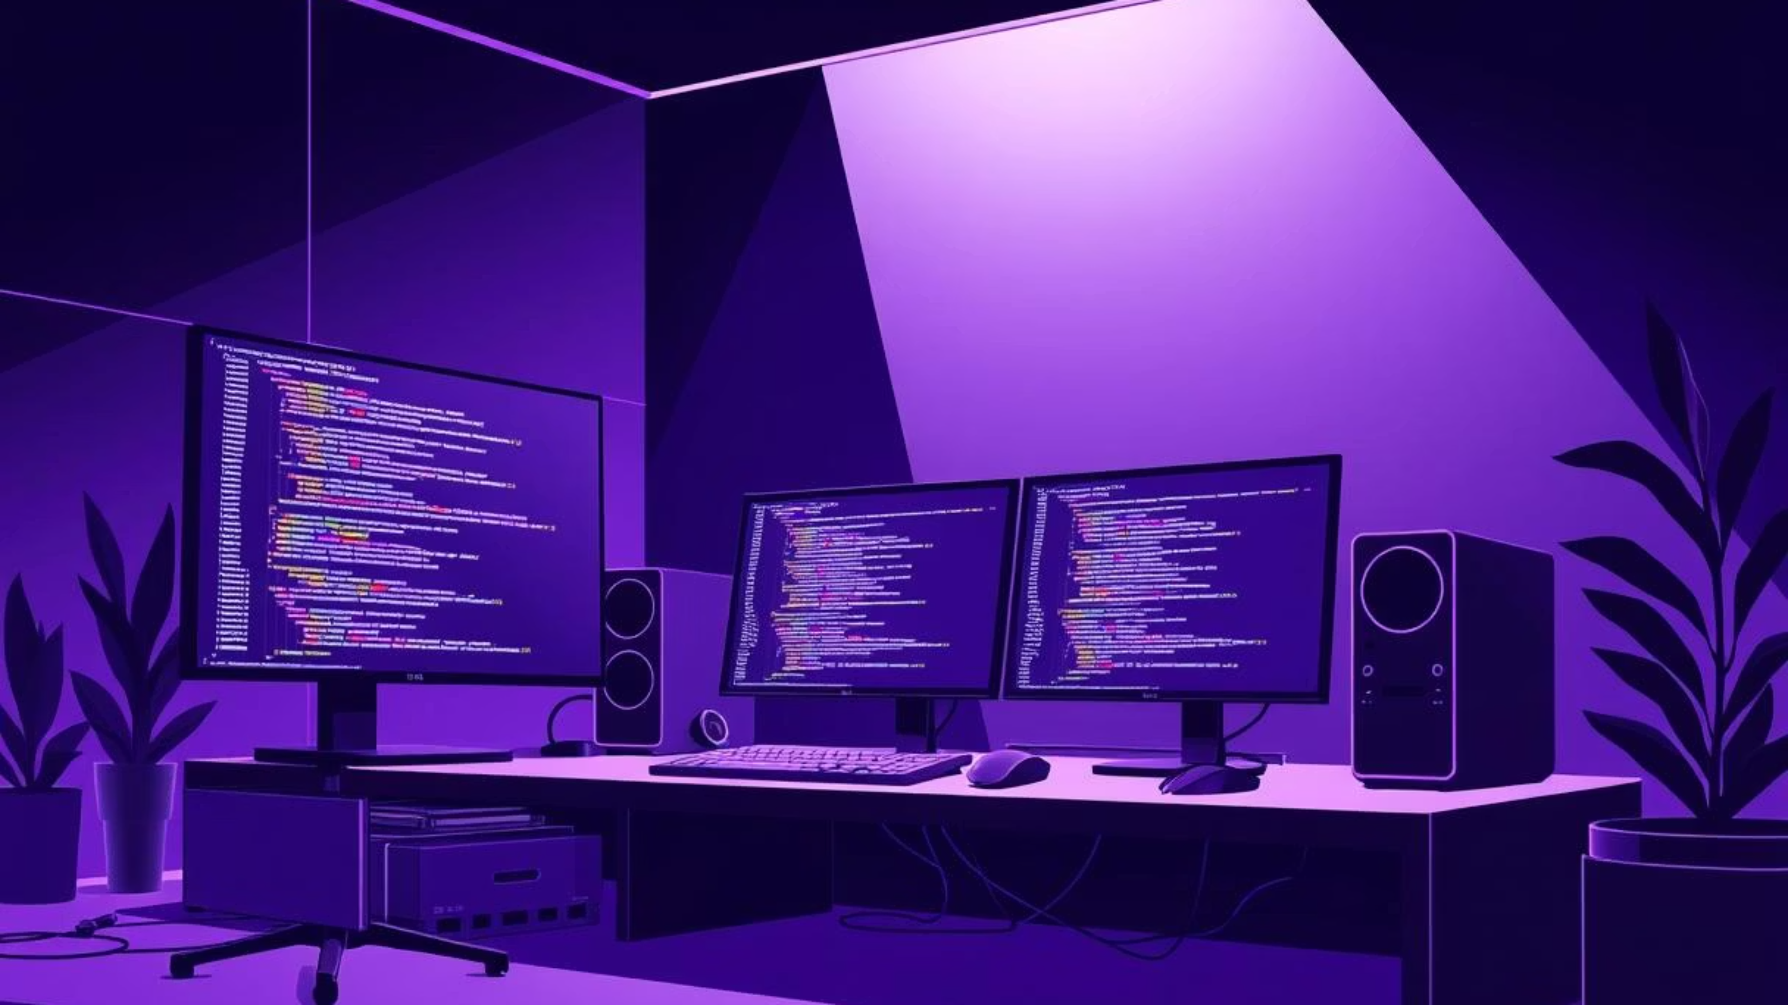
Reva University
Portfolio – Modern Web Developer Portfolio
A showcase of modern web development skills
Built with Next.js, Tailwind, TypeScript & more
Name : Abrarali S.
SRN : R24DE175 Subject : Web Development

Slide 2
Project Overview: Beyond a Resume
This project is more than just a personal website; it's a living demonstration of modern web development capabilities.
Goal: Create a responsive, professional developer portfolio.
Focus: Emphasize clean code, reusability, and scalability.
Foundation: Built using the latest web development frameworks and tools.
It showcases practical application of cutting-edge technologies to deliver a polished, functional, and maintainable product.

Slide 3
Next.js: The Core Framework
Next.js serves as the powerful foundation, enabling a high-performance and scalable application.
Why Next.js?
How It Works
Leverages App Router for modern routing.
Handles both frontend rendering and server-side logic within a single, unified project structure.
Supports Server-Side Rendering (SSR) & Static Site Generation (SSG) for optimal performance and SEO.
Setup with pnpm
Integrated API routes for seamless backend functionality.
pnpm create next-app@latestcd my-apppnpm run dev
Simplified file-based routing.

Slide 4
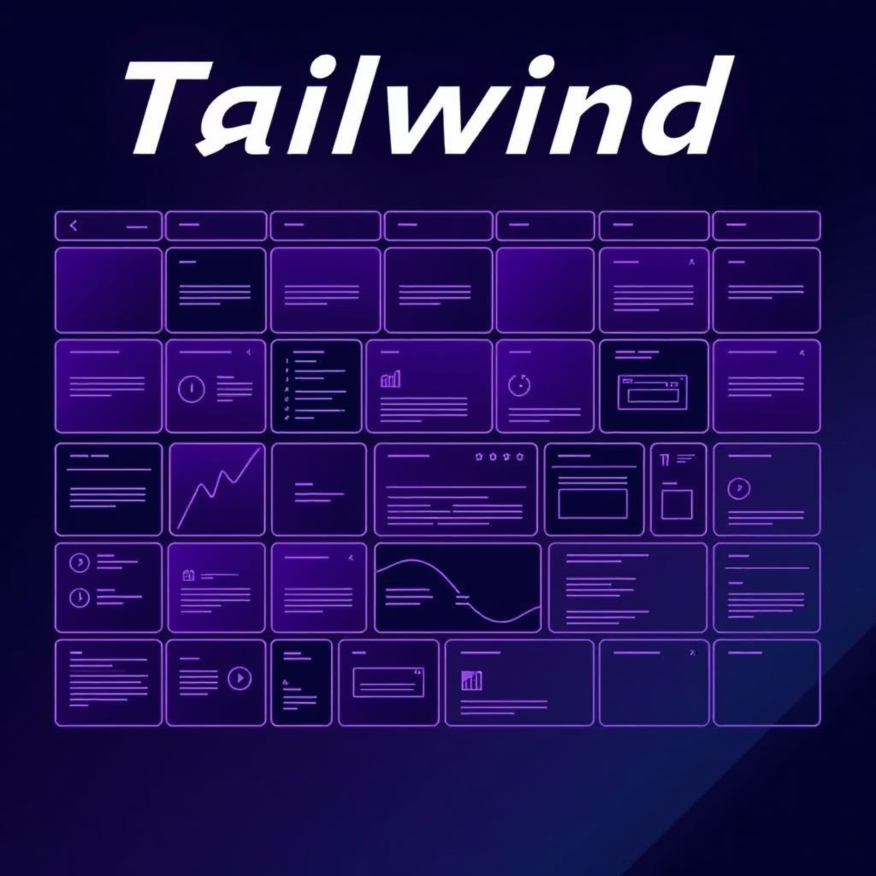
Tailwind CSS: Utility-First Styling
Tailwind CSS supercharges the styling process, enabling rapid and efficient UI development.
Utility-first framework: Build UIs directly in your markup, accelerating development.
Responsive design: Seamlessly adapt layouts across devices using built-in breakpoints.
Dynamic themes: Effortless dark/light mode support for a modern user experience.
Installation with pnpm
pnpm install -D tailwindcss postcss autoprefixerpnpx tailwindcss init -p
Example Usage
<button class="bg-blue-500 hover:bg-blue-700 text-white font-bold py-2 px-4 rounded"> Click Me</button>

Slide 5



TypeScript: Enhancing Reliability and Scale
Integrating TypeScript introduces robust type-checking, crucial for building maintainable and scalable applications.
Why Type Safety?
Developer Experience
Future-Proofing
Provides compile-time type safety, reducing runtime errors and improving code predictability.
Offers superior autocomplete and refactoring capabilities, boosting development speed and accuracy.
Prepares the portfolio for future scaling and complex feature additions, ensuring long-term maintainability.
Setup with pnpm
pnpm install typescript @types/react @types/node -D
Next.js automatically generates the tsconfig.json file, streamlining the configuration process.

Slide 6



Essential UI Components & Tools
Leveraging specialized libraries ensures a polished, accessible, and functional user interface.
Radix UI
Lucide Icons
Formspree
Provides accessible and customizable primitive UI components like dialogs, menus, and tooltips, ensuring robust user interactions.
A modern, open-source icon library offering a vast collection of clean and highly customizable SVG icons for visual flair.
Simplifies contact form integration by handling backend submission logic, allowing for direct email forwarding without complex server setup.
import { Github } from "lucide-react";

Slide 7

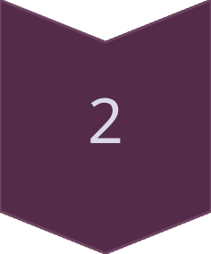
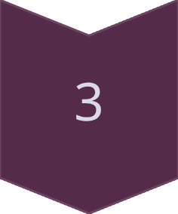
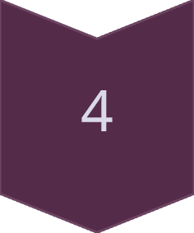

Seamless Tech Integration
The synergy of these technologies creates a robust and efficient development ecosystem.
Next.js
Routing, SSR/SSG, Server Functions
Tailwind CSS
Responsive Styling, Utility-First Approach
TypeScript
Type Safety, Maintainable Codebase
UI/UX Tools
Radix UI + Lucide Icons
Formspree
Backend-less Contact Forms
This integrated approach showcases a full spectrum of modern web development skills, from frontend design to efficient backend solutions.

Slide 8

Key Takeaways: A Modern Developer's Edge
Demonstrates Proficiency
Highlights Best Practices
Showcases practical skills in Next.js, Tailwind, and TypeScript, essential for today's web landscape.
Emphasizes clean code, reusability, and maintainability, crucial for collaborative and scalable projects.
Responsive & Accessible
Full-Stack Awareness
Built with a focus on responsiveness and accessibility (via Radix UI), ensuring a broad user reach.
Leverages Next.js API routes and Formspree to hint at backend capabilities without overcomplication.

Slide 9

What's Next?
This portfolio is continuously evolving. Future enhancements include:
Expanded Project Showcase: Adding more detailed case studies of diverse projects.
Performance Optimizations: Further fine-tuning loading speeds and resource utilization.
Interactive Demos: Integrating live, interactive components of featured projects.
Blog Section: Sharing insights and articles on web development trends and best practices.
The goal is to maintain a cutting-edge portfolio that reflects ongoing learning and adaptation to new technologies.

Slide 10
Thank You for Your Time!
I hope this presentation provided a clear insight into the technical choices and development philosophy behind this modern web developer portfolio.
Portfolio – Modern Web Developer Portfolio
Github : https://github.com/AbraraliS
Linkedin : https://linkedin.com/AbraraliS
Name : Abrarali S.
SRN : R24DE175

